Slide 1
H2O AI
https://www.linkedin.com/in/puneethkumarreddy/
https://www.linkedin.com/in/puneethkumarreddy/
Under the guidance of professor Srikanth Krishnamurthy
Team 6: Vaidehi Deshpande (linkedin.com/in/vaidehid)
puneeth kumar (https://www.linkedin.com/in/puneethkumarreddy/)
Yamini Sehrawat (linkedin.com/in/yamini-sehrawat-1a26a197)

Slide 2
Agenda
What is H2O ?
H2O Architecture
H2O flow UI
H2O on Python and R
Regression and Classification
Clustering
Anomaly Detection
Questions

Slide 3

What is H2O?
Open source, in-memory, distributed, fast, and scalable machine learning and big data analytics platform.
H2O API is Ease-to-use and adopt. Written in Java – perfect for Java programmers
REST API (JSON) – drives H2O from R, Python, Excel, Tableau
Distributed Algorithms scale to Big Data
Use all of your data - model without sampling
A number of well-known companies are using H2O for their big data processing, and the website claims that over 5000 organizations currently use it. The company behind it, H2O.ai, has over 80 staff, more than half of which are developers.

Slide 4
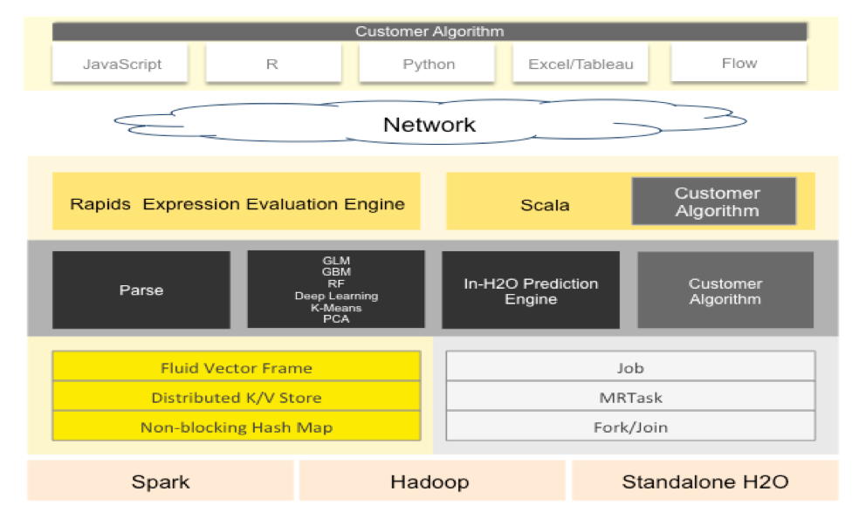
H2O Architecture

Slide 5
H2O Components
H2O Cluster
Multi-node cluster with shared memory model
Distributed key-value store
Objects in the cluster are all referenced by Key
Any node can access any object in the cluster by key.
H2O Frame
Distributed Data Frames(Collection of Vectors)
Each node must be able see entire dataset.
All computations in memory
No limit on cluster size.
Columns are distributed(across nodes) arrays.

Slide 6
Starting with H2O

Slide 7
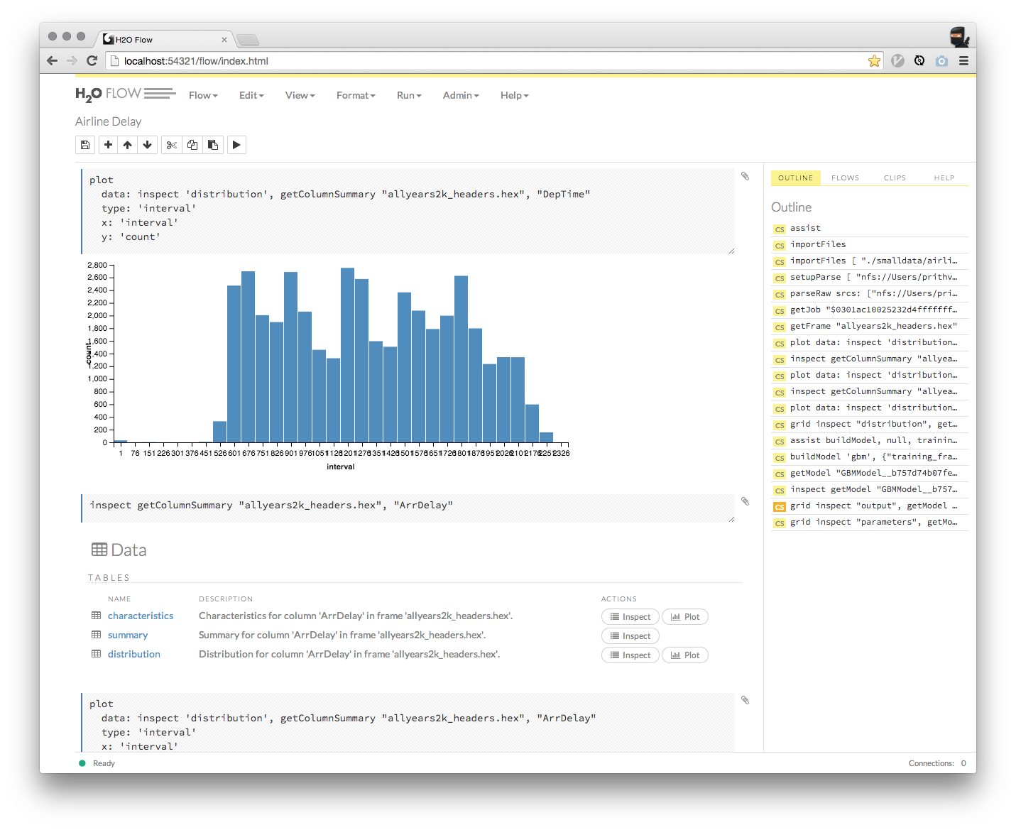
H2O Flow UI
Open Source user interface for H2O.
Web-based Interactive Computing Environment for Big Data Machine Learning.
Supports REST API, R scripts, and CoffeeScript, Charts and Visualization etc. no programming experience is required to run H2O Flow.
Model Comparisons.
Easy to install :
http://www.h2o.ai/download/

Slide 8
Algorithms on H2O
Supervised
Unsupervised
Statistical Analysis
Linear Models(GLM)
Naïve Bayes
Ensembles
Random Forests
Distributed Trees
Deep Neural Networks
Multi-Layer Feed-Forward Neural Network
Gradient Boosting Machines
R Package – Super learner Ensembles
Deep Learning
Clustering
K-Means
Dimension Reduction
Principal Component analysis
Generalized Low Rank Models
Anomaly Detection
Auto-encoder

Slide 9
H2O with R and Python : Demo
R
Prerequisite: R>=3.1.0 and Java 7 or later.
Python
Prerequisite: Python 2.7 or 3.5 and Java 7 or later. A few python module dependencies
All Computations are performed in the H2O cluster and initiated by REST calls from R/Python.

Slide 10

Regression & Classification : Demo
Linear Regression in R and Python
Linear regression is an approach for modelling the relationship between a scaler dependent variable y and one or more explanatory variable( or independent variables) denoted by X.
Random-Forest in R and Python
It is a decision tree algorithm also known as ensemble algorithm, where a group of weak models combine to form a powerful model.

Slide 11
Clustering : Demo
H2O Supports k-means Clustering
K-means Clustering -- Find n centerpoints upon which the distance between the members of the cluster
can be minimized(“Within cluster Sum Of Squares” – WCSS)
K-means can be solved in reasonable time with fixed dimensionality and number of clusters
3 steps:
--- Decide what you’re going to cluster on
--- Initialize the set – k-means++
--- Run some sort of optimized algorithms

Slide 12
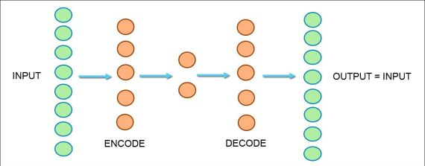
Anomaly Detection: Demo
Anomaly detection (or outlier detection) is the identification of items, events or observations which do not conform to an expected pattern or other items in a dataset
H2o offers and easy to use, unsupervised and non-linear auto-encoder as part of its deep-learning model.
The idea is to use the input data to predict the input data by means of a “bottle-neck” network.
The middle layer can be regarded as a compressed representation of the input.

Slide 13

Thank you…

Slide 14
References
http://docs.h2o.ai/h2o/latest-stable/index.html
http://proquest.safaribooksonline.com.ezproxy.neu.edu/book/programming/machine-learning/9781491964590/1dot-installation-and-quick-start/chapter_introduction_html
http://amunategui.github.io/anomaly-detection-h2o/#autoencoder
https://github.com/h2oai/h2o-meetups
https://www.youtube.com/watch?v=hPkyNhMR36E
http://h2o-release.s3.amazonaws.com/h2o/rel-turing/10/index.html

